Slide 1


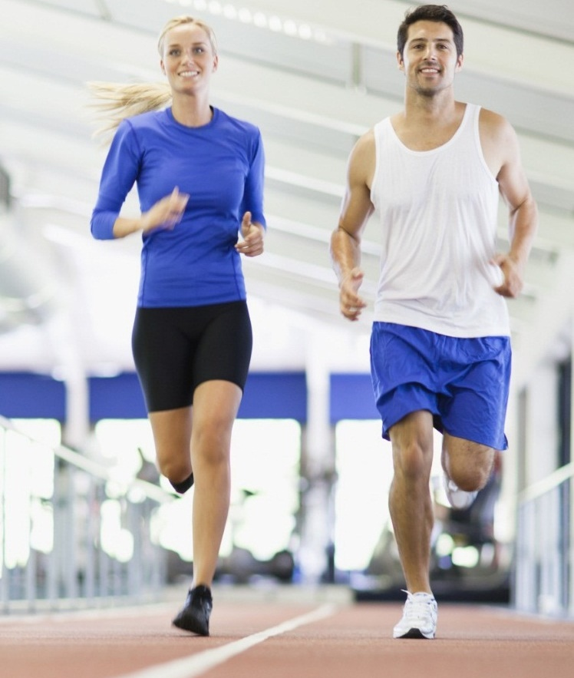
Finding best location for Fitness centar in Toronto
Coursera IBM Data Science Capstone Project

Slide 2
Introduction
find best location in Toronto area to open Fitness centar
With modernization of society we have been less and less active which started affecting health of the population.
Increasing number of people are becoming overweight in developed countries. But on the bright side, with social media, fitness and health has become popular so there is demand for the fitness centers especially in big cities like Toronto. dd your first bullet point here
Idea is to use data science methods learned during this Capstone, such as clustering, segmentation and with the help of Foursquare API

Slide 3
Why toronto?
most populous city in Canada and the fourth most populous city in North America
Ione of the most multicultural and cosmopolitan cities in the world
one in three (33%) Canadians say improving their personal fitness and nutrition is their top new year's resolution, compared with only 21 per cent who chose to focus on financial goals
More than half (53%) of Canadians say improving their overall quality of life is the primary motivation for pursuing a health and wellness resolution. Preventing health risks (45%), losing weight (42%) and increasing their energy (41%) ranked as other top reasons to exercise more and eat better
One in five Canadians (18%) say they would join a gym. Which means that demand for the fitness facilities in Toronto.

Slide 4
Libraries used:
Pandas: For creating and manipulating dataframes
Folium: Python visualization library – used to visualize cluster distribution
Scikit Learn: importing k-means clustering
JSON: Library to handle JSON files
XML:
Geocoder: To retrieve Location Data
Beautiful Soup: to scrap and library http requests
Matplotip: Python Plotting Module

Slide 5
Data used:
List of neighborhoods in Toronto, https://en.wikipedia.org/wiki/List_of_postal_codes_of_Canada:_M
Latitude and Longitude of neighborhoods
Venue dana related to Gym/Fitness centers.
Methods for extracting data:
Web scraping of Toronto neighborhoods from Wikipedia
Using Geocoder package for latitude and longitude data of neighborhood
Using Foursquare API to get venue data

Slide 6
Methodology:
First challenge of this project was finding list of neighborhoods in Toronto, Canada.
scrapped from Wikipedia page (https://en.wikipedia.org/wiki/List_of_postal_codes_of_Canada:_M), by using pandas html table scrapping method and Beautiful Soup
find coordinates Geocoder package is used and then map is created and visualized using Folium package to better understand positions and density of venues in different neighborhoods.
Foursquare API is used to extract list of the top 100 venues within 500 meters radius. to see the frequency of each specific category.
ccategory “Gym/Fitness centar” is searched so we can see where are they located, where is good place to open new fitness centar.
This is done with clustering method by using k-means clustering
Neighborhoods were clustered in 3 clusters based on their frequency of occurrence of “Gym/Fitness venue”.

Slide 7
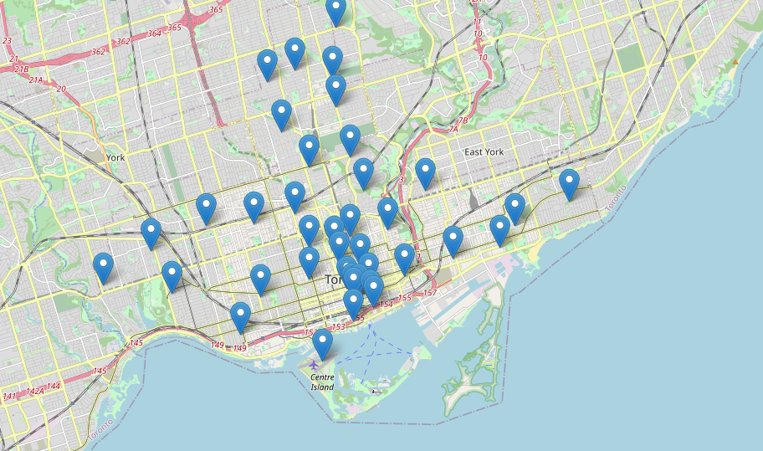
Map of toronto

Slide 8
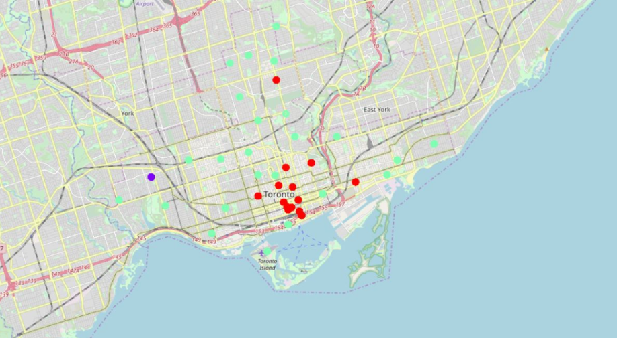
Fitness centers

Slide 9
Results
Results show that lowest number of fitness centers are in clusters 0 and 1, while largest in cluster 2.
recommendation would be too look at possible locations for opening fitness centar in cluster 1 and cluster 0, which is around neighborhoods such as Agincourt, Moore Park, Harbourfront East, Golden Mile, Clairlea, Oakridge in cluster 0 or Downsview, Parkview Hill, Woodbine Gardens, Davisville North in cluster 1
Cluster 2 with neighborhood such as Garden District, Ryerson, Underground city, etc. Is too busy with fitness centers and gym, so it would be really hard to attract new customers
most of clients prefer gym that they know, and they have some sort of brand loyalty and they prefer to go to closest gym to their home.

Slide 10
Conclusion
most of the people prefer fitness centers and gyms that are close to their home
open fitness centar in the neighborhood where there is least number of similar venues to attract new customers who are maybe driving to the gym that is far away from them because they don’t have better option
by building initial customer base of people who live closest to fitness centar, business will have enough profit to return initial investment and to invest more in marketing to attract customers that live little further away.

